Slide 1

Hustlers_VIT
Anisha Ghosh
Aditya Mitra
Gautam Galada
Varanasi Kasyap
Riya Rai
Manognya Dasika
Mentors:
Dr S Chakkaravarthy
Dr S Priyanka
(VIT-AP University)

Slide 2

Problem statement (AT985)
The System would Transfer Multimedia Data through Police Radio Sets:
1. Images
2. Video
3. MP3/MP4
This would focus on securely transmitting sensitive data over radio sets.
Why is this useful when the Police personals could use smartphones directly?
This is useful because transmission over smartphone always carries some risks. Multimedia Messages (MMS) could be logged at the service provider. While online transmission like sending over WhatsApp or Emails could be logged by the apps.
In case of areas of political unrest, it has been observed that an Internet blackout is used to prevent the spread of misinformation and all. Transmission over smartphones would not work in these cases.
Smartphone communication does not usually support ‘broadcast’ where a piece of information is to be sent to all other personals in a given range.
Police radio work on UHF (Ultra High Frequency) which is more reliable than normal cellular connectivity.
Why this problem statement?
This, when implemented, would solve the problem of secure communication of police personals.

Slide 3
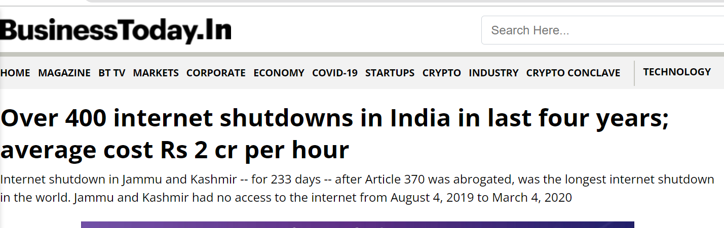
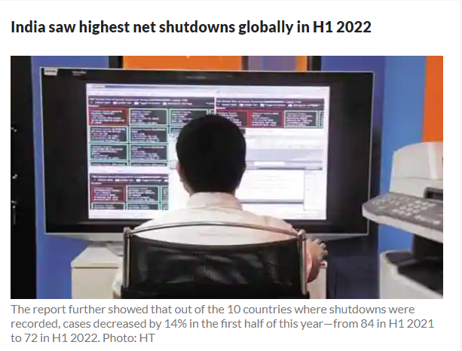
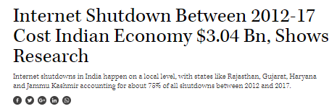
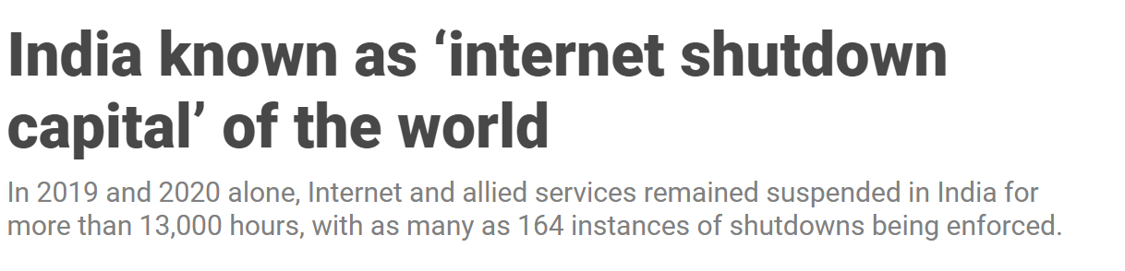
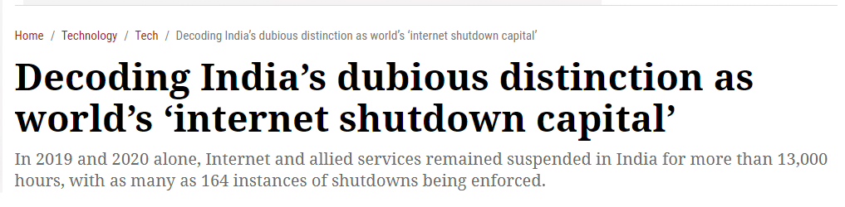
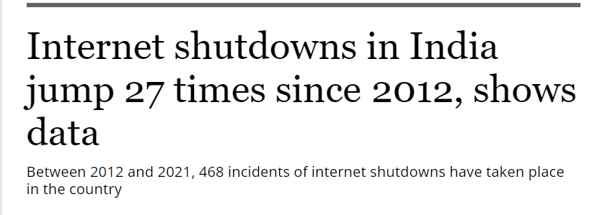
Reported Internet Shutdown Cases

Slide 5
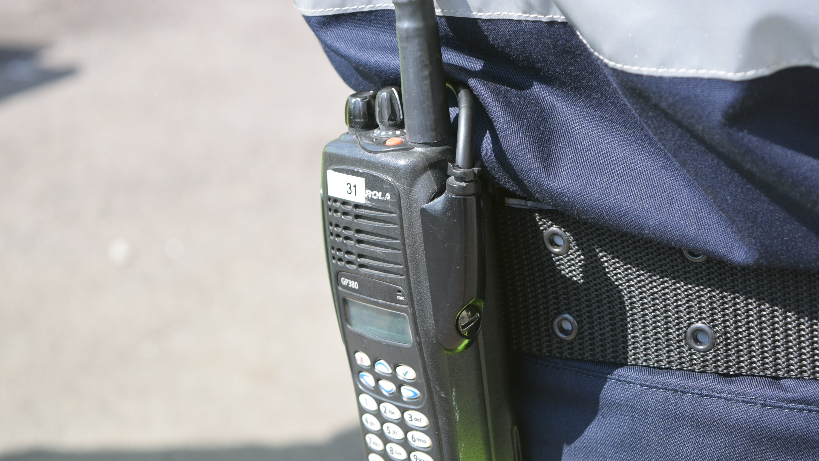
The Indian Police Communication System
The Police handsets are mini radio sets that work on VHF and UHF frequency ranges. They can communicate only in the line of sight, so the police use repeater stations to extend their range.
These wireless repeater stations do the job of relaying signals of Walkie-Talkies that are not in the line of sight. The radio frequency range band of UHF is 76 Mega Hertz to 86 Mega Hertz.
These handsets are radio stations in themselves and don't need any kind of towers to operate. In cases of an emergency, the police wireless networks will stand the test of time.
The shortcomings are in the process of slow information collection and uneven access, use, and familiarity with technology, particularly at the cutting-edge level.

Slide 6

Recent Cases of Illegal Interception
Feb 2012, Kochi*: Rampant usage of wireless equipment by unauthorized persons resulted in leakage of police communications between control rooms. Most Chinese-made FM radio sets in the market have FM bandwidth from 70Mhz to 200MHz can be used to tune in to police bandwidth of 76Mhz to 86Mhz.
May 2015, Bhopal*: A person running a security agency was arrested with wireless sets tuned to Army and Cop frequencies. He was believed to have connections with Pakistan and was keeping taps on VIP movements.
(*Source TOI)

Slide 7
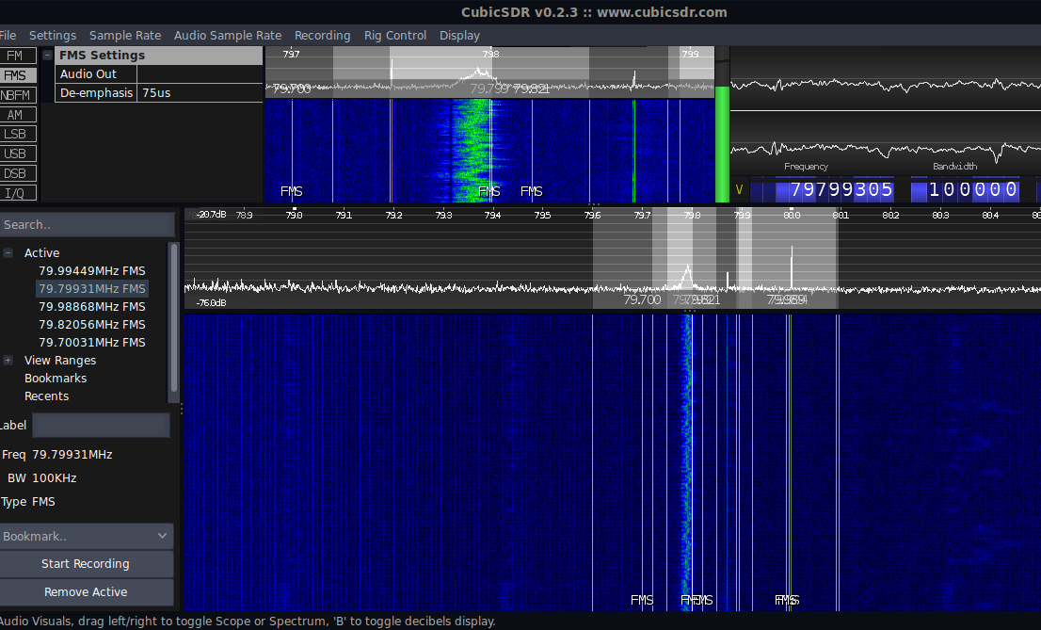
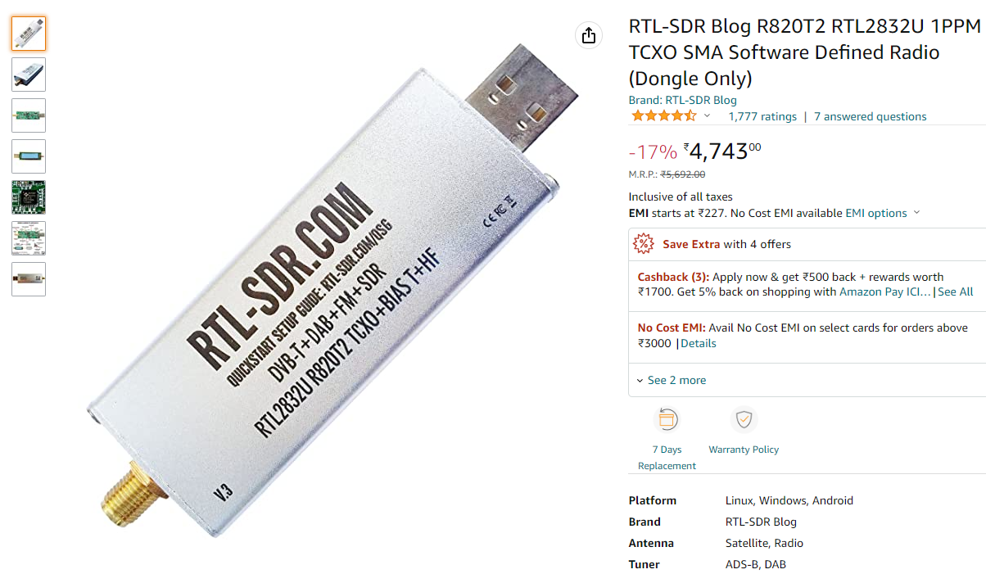
Interception of Radios
It is really easy to intercept all types of radio communications, including that of Police radios with Software Defined Radio (SDR) modules, which are again openly available on e-commerce websites like Amazon. Open-source applications like GNU-Radio, CubicSDR, etc., can be used to tune into the radio frequencies and record or listen. Hence, the proposed solution implements AES for encrypting the transmitted data so that intercepts cannot be decrypted to get the original content.

Slide 8
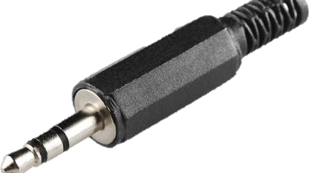
Unique solution
The way we decided to approach the problem statement would be kind of unique. We did not just solve the problem for police radios, but we have come up with a solution for secure, robust and highspeed file transmission for any device supporting audio transmission. This can be police radios, the civilian walkie talkies and even wired and wireless phone lines. Hence, we claim that if not just police, other personals in duties like that of security guards to even army personals would be benefited with this product.
This generalized solution features a plug and play type connectivity where it can just be plugged into the communication device like a police radio. It provides a 3.5mm audio jack interface which requires no further driver support or anything. And even if the communicating device does not have a 3.5mm audio jack, the wires can be directly soldered with the microphone and speaker of the given device.

Slide 9

Features
The features of our solution include:
•End-to-end encryption: The solution provides an option to encrypt the data during transmission. This is done so that no eavesdropper would be able to get the transmitted information even though they successfully manage to tap into the wireless frequency.
•Data compression: The solution compresses the input files before transmission so that the essential information is not lost during transmission, but the file size is lowered for faster communication.
•Support for steganography: Images with steganographic information may not be compressed during transmission so as to retain the data without loss. However, they might still be encrypted for additional security.
High-speed transmission: 2 kB/s

Slide 10

Compression
Image files: Colors are reduced to use only 256 colors from the palette. This reduces the file type to nearly half the original size. PNG and JPEG files are supported. We have successfully compressed a 46.8kB test PNG file to 24.35kB.
Video files: Each frame is resized to one-fourth of its length and one-fourth of its height; thus, the area is reduced to one-sixteenth of its original area. We have successfully compressed a 1.3MB test video file to 616 kB.
Audio files: A Fourier transform is taken of the input waveform. Considering, the input sample rate to be Fs, we consider the Nyquist-Shannon theorem. Thus, we consider frequencies only below Fs/2. A parameter e is used to indicate the section of the spectrum not to be considered. We have used e=10⁻⁵ for removing a small portion. Increasing the parameter e deteriorates the quality of the audio. We have successfully compressed a 5MB audio file to 2MB.

Slide 11
Compression data
Type | Size of input file(Bytes) | Size of Compressed file(Bytes) | Compression Time | Compression Ratio(%) | Time Complexity
Image | 5064629 | 701980 | 796ms | 13.86% | O(N log N)
Audio | 32069287 | 16034665 | 9.05s | 50% | O(N)
Video | 9840497 | 266619 | 5s | 2.7% | O(M*N) Where m is no of frames and n is no of pixels per frame

Slide 12

Transmission channels and modulation
4 frequencies are used in the audio channel simultaneously for fast transmission. The 4 frequencies are 2kHz, 3kHz, 4kHz, and 5kHz. A CRC-32 checksum is verified on every 250-byte data frame to confirm that the correct sequence is received.
Quadrature Phase Shift Keying (4-PSK) modulation algorithm is used on the given carrier frequencies. For instance, a single 4-PSK encoding can have one of four states, thus transmitting at double the speed of the Binary Phase Shift Keying (BPSK) algorithm.

Slide 13
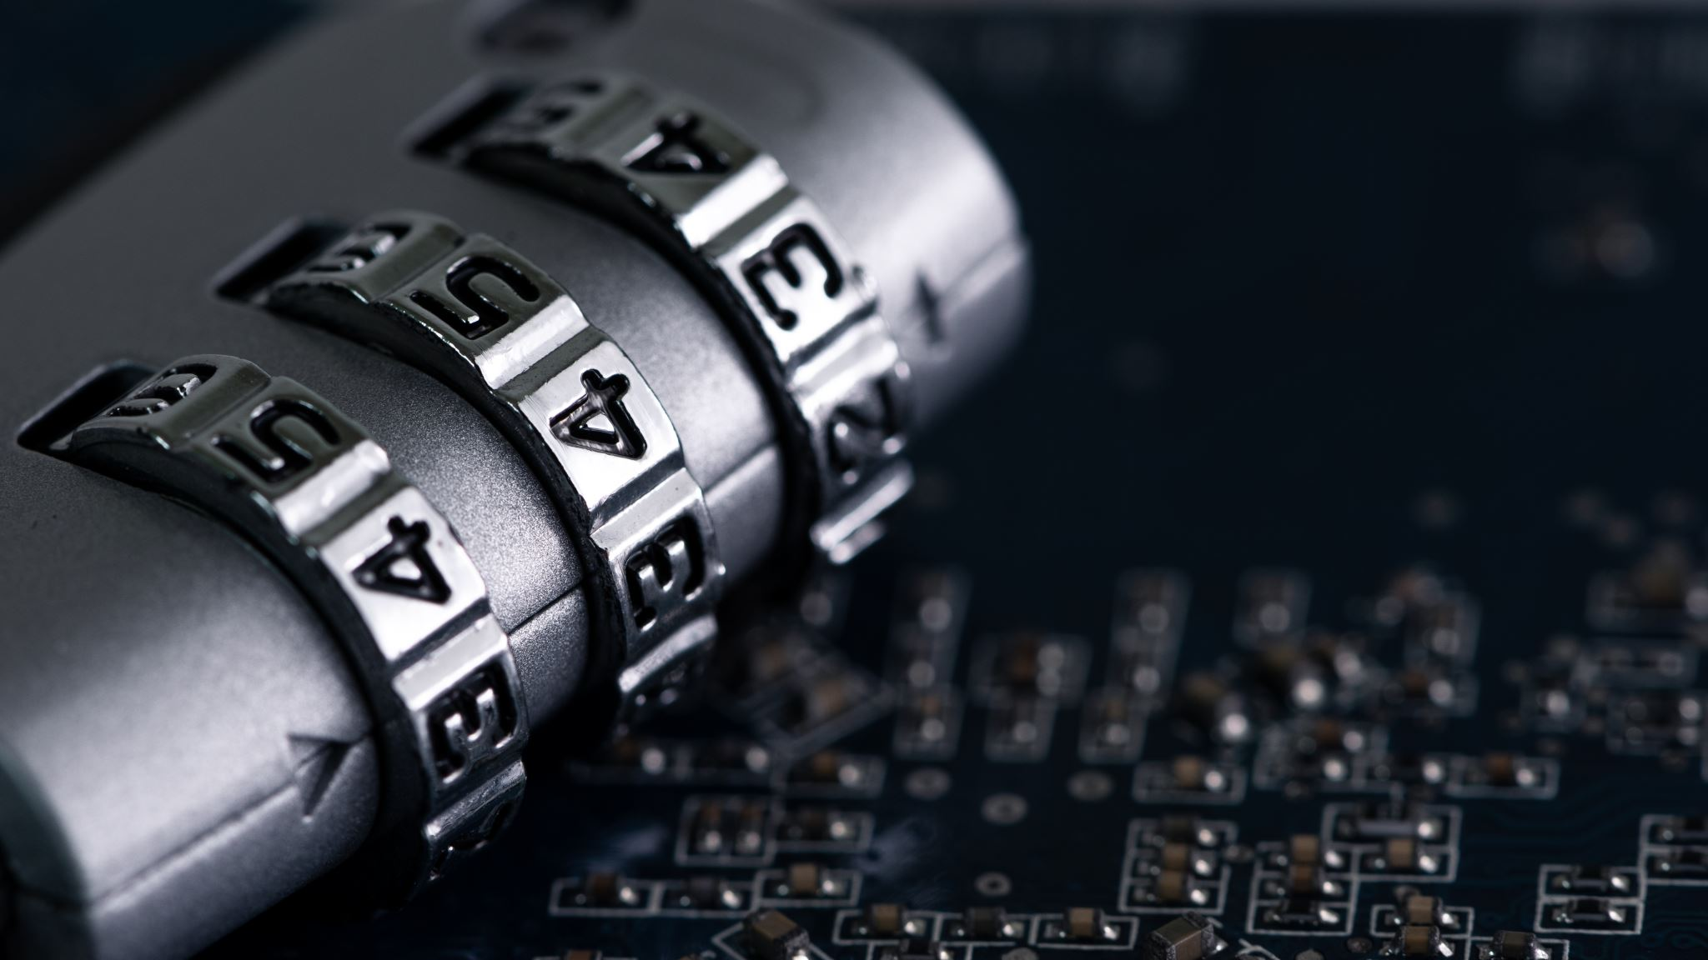
Encryption
Uses AES (Advanced Encryption Standard).
Data is protected by a strong password

Slide 14

Innovation
Implemented a robust and secure pipeline for transmission of files over radio.
The files are encrypted to prevent eavesdropping or interception.
Bigger files are compressed with high compression ratio for faster transmission.
Files with steganographic information will retain the steganographic information after transmission.
A plug and play solution for any radios including police radios.
Also suitable for civilians like security guards who mainly communicate over radios.

Slide 15

Business model
Being a software dependent solution, the solution is extremely low cost and can be implemented with the help of sound cards costing as low as ₹100, the price would decrease for bulk production. However, better sound cards can provide transmission speed up to 10kB/s.
The target market would be Police, Army, Security organizations and so on.
As a start-up, we would provide regular updates to the software including patches for the encryption systems, the compression modules and so on.
Once a large section of the target market, like the police implements the solution, we can go for public key cryptosystem, where the public keys for important personnel could be announced and the others may use the same to encrypt very confidential file without the difficulty of key-exchange.
With partnership with start-ups like Mukham Pvt. Ltd., we can provide multi-modal authentication services for remote assets over radio that would not necessarily depend on internet, cellular or telephony connectivity.

Slide 16
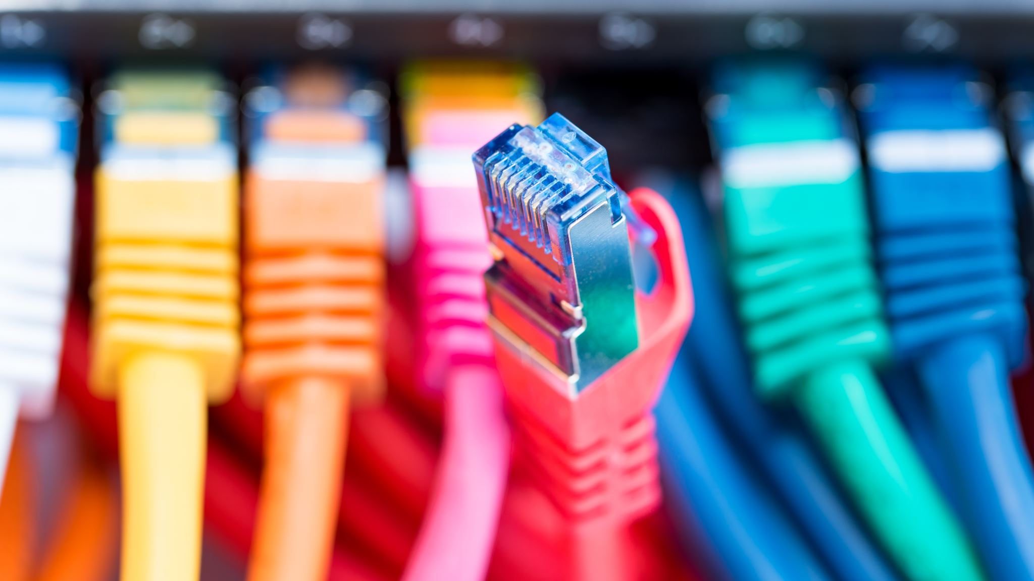
Thank you

